Slide 1
Stock Trading Project
Dhivahar Perumal and Rajesh Mohan

Slide 2
Model Design
LSTM Neural Network for Set Point Calculation
Stock Prices
Predicted Profit
Optimizer
MLP Neural Network for Control Calculation
Trading Module
Actual Profit
Feedback

Slide 3
Trading Module
The Trading Module carries out the trade as a separate thread
The trades are considered to be based on the output by the combined controller + Neural Network.
As long as the actual profit is less than the predicted profit, the trade is performed.
No more trades are performed if there is a loss predicted for the day.

Slide 4
Initial Profit Prediction
The Initial profit to be expected is predicted before the trade for the day is performed.
We have a Neural Network model that studies the data over a period of 20 years and predicts the very next day stock closing price.
We consider a buy and sell points over the next N day where we expect to buy and sell the stocks at the closing prices(predicted from the NN).
We consider this to be an abstract that tells us if there is a profit possible for the next N days and if yes, the buy and sell points.

Slide 5
Initial Profit Prediction
We have the Previous Closing Day Value ( CloseValue(t))
We predict the Current Day Closing Value using the Neural Network Prediction system implemented using LSTM ( CloseValue(t+1) ) till N days .
The total profit that could be obtained over the period is calculated by the max profit alogirthm and we get to know the buy and sell points over the next N days.
This is given by,
Expected Profit ,P(e) = Sum (Each profit by the trade)

Slide 6
Stock Closing Price Prediction Using LSTM
We have built the stock closing price prediction using the historic data.
The mean square error is 0.29 on test data.
This is a robust prediction system that could estimate the closing value with an considerable accuracy.
This is very important since we are not only concerned if the day will result in a profit but also how much of the profit.
This could be extended by predicting the Day High Value instead of the day close value for better prediction.

Slide 7
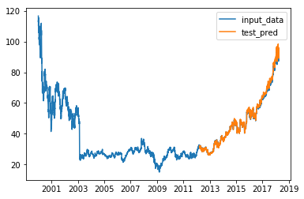
Stock Closing Price Prediction Using LSTM
Stock Price
Time ( t )

Slide 8
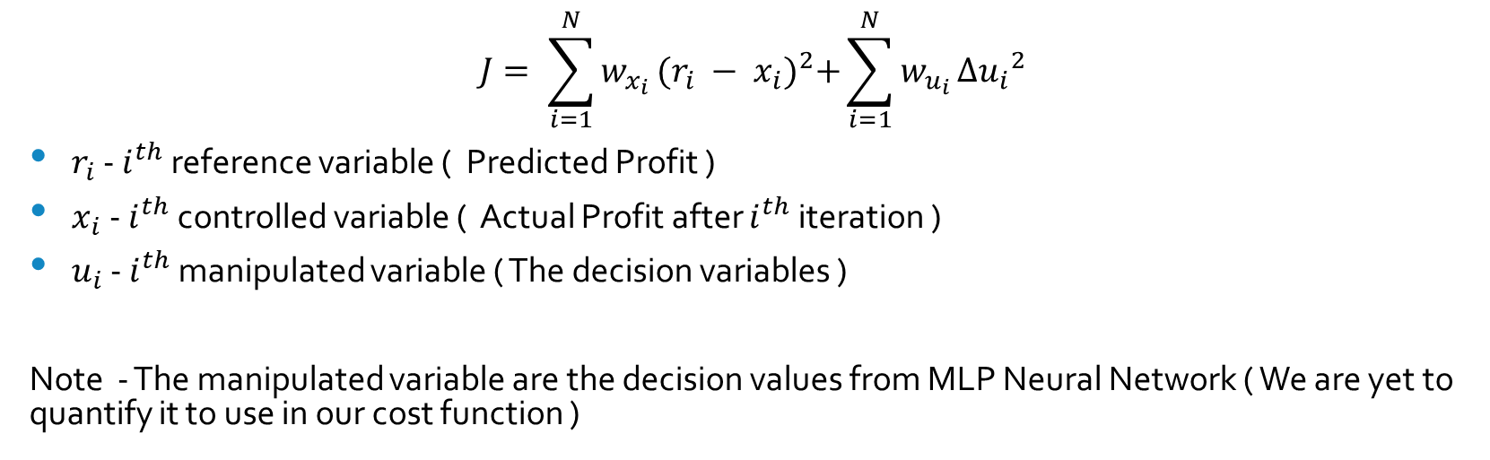
Cost Function
$$J= \sum_{i=1}^{N}{w_{x_{i}}}{(r_{i} − x_{i})}^{2}+\sum_{i=1}^{N}{w_{u_{i}}}Δ{u_{i}}^{2}$$
$r_{i}$ - $i^{th}$ reference variable ( Predicted Profit )
$x_{i}$ - $i^{th}$ controlled variable ( Actual Profit after $i^{th}$ iteration )
$u_{i}$ - $i^{th}$ manipulated variable ( The decision variables )
Note - The manipulated variable are the decision values from MLP Neural Network ( We are yet to quantify it to use in our cost function )

Slide 9
Predicted Profit Value
Actual Profit Value
Profit
Sell
Trade2
Trade1
Sell
Buy
Buy
No Trade Period
Time
k
k+1
k+2
k+n

Slide 10
Work Done Till Now
We have prediction system designed over the days.
We have historical data only for day closing price of stocks. In order to design a model for intraday transaction, we are creating our own training and test data sets
We have the model for the MPC and a trivial cost function.
The prediction system is a neural network using LSTM and Multi-Layer Perceptron to predict the prices over the next N days.

Slide 11
Work to be Done
We have the model to predict the value in N days, But once the training data set for intraday trading is complete , we can use it to train for intraday training.
The Same logic governing the stock trading over N days will be scaled to stock trading over N minutes.
The cost function needs to be optimized. We have to consider the scenario where the actual profit is more than the predicted profit ( that mean we have outperformed our prediction). In such scenarios, we must not over try the inverse and bring down our profit( but instead allow it to maximize it )

Slide 12

Data sets to be used for intraday trading

